Slide 1



Lecture -3
Programming in Python
AALWAHAB DHULFIQAR ZOLTAN
What you will learn:
Making decisions (if statement) loops
logic and bitwise operations lists in Python
Functions, tuples and dictionaries

Slide 2
Questions and answers
Comparison: equality operator
Fortunately, computers know only two kinds of answers:
yes, this is true;
no, this is false.
Question: are two values equal?
To ask this question, you use the == (equal equal) operator. It is a binary operator with left-sided binding. It needs two arguments and checks if they are equal.
Example : A==B or A!=B
Comparison operators: greater than
Question: are two values equal?
You can also ask a comparison question using the > (greater than) operator.
black_sheep > white_sheep # Greater than
How to ask python a question
To ask questions, Python uses a set of very special operators.

Slide 3
Comparison operators: greater than or equal to
>= (greater than or equal to).
< (less than) operator .
<= (less than or equal to)
Priority | Operator
1 | +, - | unary
2 | **
3 | *, /, //, %
4 | +, - | binary
5 | <, <=, >, >=
6 | ==, !=
Making use of the answers
Conditions and conditional execution
if a condition is met, and not do it if it isn’t.
store it in a variable
make a decision
about the future of
if true_or_not: do_this_if_true
A = B == D
the program
if sheep_counter >= 120: make_a_bed() take_a_shower() sleep_and_dream()
feed_the_sheepdogs()
Ex:
if the_weather_is_good: go_for_a_walk()
have_lunch()

Slide 4
The elif statement
Conditional execution: the if-else statement
if true_or_false_condition: perform_if_condition_true
else:
perform_if_condition_false
if the_weather_is_good:
if nice_restaurant_is_found: have_lunch()
else:
eat_a_sandwich() else:
if tickets_are_available: go_to_the_theater()
else:
go_shopping()
if the_weather_is_good: go_for_a_walk()
elif tickets_are_available:
go_to_the_theater()
elif table_is_available: go_for_lunch()
else:
play_chess_at_home()
if the_weather_is_good: go_for_a_walk()
else:
go_to_a_theater() have_lunch()
if the_weather_is_good: go_for_a_walk() have_fun()
else:
go_to_a_theater() enjoy_the_movie()
have_lunch()

Slide 5
Pseudocode and introduction to loops
An infinite loop
How you think when you want to write a program?
largest_number = -999999999
number = int(input())
if number == -1:
print(largest_number)
exit()
if number > largest_number:
largest_number = number
# Go to line 02
while True:
print("I'm stuck inside a loop.")
# Store the current largest number here. largest_number = -999999999
# Input the first value.
number = int(input("Enter a number or type -1 to stop: "))
Looping your code with while
# If the number is not equal to -1, continue. while number != -1:
# Is number larger than largest_number? if number > largest_number:
# Yes, update largest_number. largest_number = number
# Input the next number.
number = int(input("Enter a number or type -1 to stop: "))
while conditional_expression:
instruction_one instruction_two instruction_three
:
:
instruction_n
while there is something to do do it
while conditional_expression: instruction
# Print the largest number.
print("The largest number is:", largest_number)

Slide 6
The break and continue statements
Looping your code with for
i = 0
while i < 100:
# do_something() i += 1
--------------------------------------------------
for i in range(100): # do_something() pass
break - exits the loop immediately, and unconditionally ends the loop's operation; the program begins to execute the nearest instruction after the loop's body;
continue - behaves as if the program has suddenly reached the end of the body; the next turn is started and the condition expression is tested immediately.
# break - example
print("The break instruction:") for i in range(1, 6):
if i == 3: break
print("Inside the loop.", i) print("Outside the loop.")
for i in range(10):
print("The value of i is currently", i)
for i in range(2, 8):
print("The value of i is currently", i)
Warning ! Donot do this
for i in range(1, 1):
print("The value of i is currently", i)
Or this
for i in range(2, 1):
print("The value of i is currently", i)
Example:
power = 1
for expo in range(16):
print("2 to the power of", expo, "is", power) power *= 2
# continue - example
print("\nThe continue instruction:") for i in range(1, 6):
if i == 3: continue
print("Inside the loop.", i) print("Outside the loop.")

Slide 7
The while loop and the else branch
Computer logic
i = 1
while i < 5: print(i)
i += 1
else:
print("else:", i)
1
2
3
4
else: 5
Argument A | Argument B | A and B
False | False | False
False | True | False
True | False | False
True | True | True
for i in range(5):
print(i)
else: | 0
print("else:", i) | 1
 | 2
i = 111 | 3
for i in range(2, 1): | 4
print(i) | else: 4
else: | else: 111
print("else:", i)
Argument A | Argument B | A or B
False | False | False
False | True | True
True | False | True
True | True | True
Argument | not Argument
False | True
True | False

Slide 8


Logical expressions
not (p and q) == (not p) or (not q) not (p or q) == (not p) and (not q)
Bitwise operations (~)
Argument | ~ Argument
0 | 1
1 | 0
Logical values vs. single bits
i = 1
j = not not i
Bitwise operators
Bitwise operations (&, |, and ^)
Argument A | Argument B | A & B | A | B | A ^ B
0 | 0 | 0 | 0 | 0
0 | 1 | 0 | 1 | 1
1 | 0 | 0 | 1 | 1
1 | 1 | 1 | 1 | 0

Slide 9

Logical vs. bit operations
How to deal with single bits?
i = 15
j = 22
i: 00000000000000000000000000001111
j: 00000000000000000000000000010110
flag_register = 0x1234
flag_register = 0000000000000000000000000000x000
log = i and j
True
logneg = not I False
x & 1 = x x & 0 = 0
the_mask = 8
if flag_register & the_mask: # My bit is set.
else:
# My bit is reset.
bit = i & j i
j
00000000000000000000000000001111
00000000000000000000000000010110
x | 1 = 1 x | 0 = x
bit = i & j 00000000000000000000000000000110
x = x & y | x &= y
x = x | y | x |= y
x = x ^ y | x ^= y
x ^ 1 = ~x
x ^ 0 = x
Binary left shift and binary right shift
var = 17
var_right = var >> 1
var_left = var << 2
print(var, var_left, var_right)

Slide 10

The len() function
Why do we need lists?
The length of a list may vary during execution. New elements may be added to the list, while others may be removed from it. This means that the list is a very dynamic entity.
If you want to check the list's current length, you can use a function named len() (its name comes from length).
The function takes the list's name as an argument, and returns the number of elements currently stored inside the list (in other words - the list's length).
var1 = int(input()) var2 = int(input()) var3 = int(input()) var4 = int(input()) var5 = int(input()) var6 = int(input())
:
:
list is a collection of elements, but each element is a scalar.
numbers = [10, 5, 7, 2, 1]
How do you change the value of a chosen element in the list?
numbers = [10, 5, 7, 2, 1]
Removing elements from a list del numbers[1]
Negative indices are legal
numbers = [111, 7, 2, 1] print(numbers[-1]) print(numbers[-2])
numbers[0] = 111 <- indexing numbers[1] = numbers[4] print(numbers) print(numbers[0])
print("\nList length:", len(numbers))
1
2
You can't access an element which doesn't exist
print(numbers[4]) numbers[4] = 1

Slide 11
Functions vs. methods
result = function(arg) ← Function result = data.method(arg) ← Method
my_list = [] # Creating an empty list.
for i in range(5): my_list.append(i + 1)
Adding elements to a list: append() and insert()
print(my_list)
 | numbers = [111, 7, 2, 1]
 | print(len(numbers))
 | print(numbers)
 | ###
list.append(value) list.insert(location, value) | numbers.append(4) print(len(numbers)) print(numbers)
 | ###
 | numbers.insert(0, 222)
 | print(len(numbers))
 | print(numbers)
my_list = [10, 1, 8, 3, 5]
total = 0
for i in range(len(my_list)): total += my_list[i]
print(total)
my_list = [10, 1, 8, 3, 5] length = len(my_list)
for i in range(length // 2):
my_list[i], my_list[length - i - 1] = my_list[length - i - 1], my_list[i]
print(my_list)

Slide 12
The inner life of lists
Sorting a list
my_list = [] swapped = True
num = int(input("How many elements do you want to sort: "))
for i in range(num):
val = float(input("Enter a list element: ")) my_list.append(val)
while swapped: swapped = False
for i in range(len(my_list) - 1):
if my_list[i] > my_list[i + 1]: swapped = True
my_list[i], my_list[i + 1] = my_list[i + 1], my_list[i]
print("\nSorted:") print(my_list)
list_1 = [1] list_2 = list_1 list_1[0] = 2 print(list_2) | Output = 2?
Slices
my_list[start:end]
# Copying the entire list.
list_1 = [1] list_2 = list_1[:] list_1[0] = 2 print(list_2)
# Copying some part of the list. my_list = [10, 8, 6, 4, 2]
my_list = [10, 8, 6, 4, 2] new_list = my_list[1:3] print(new_list)
my_list = [10, 8, 6, 4, 2] new_list = my_list[1:-1] print(new_list)
new_list = my_list[-1:1] print(new_list)
my_list = [8, 10, 6, 2, 4] my_list.sort() print(my_list)
[ ]

Slide 13
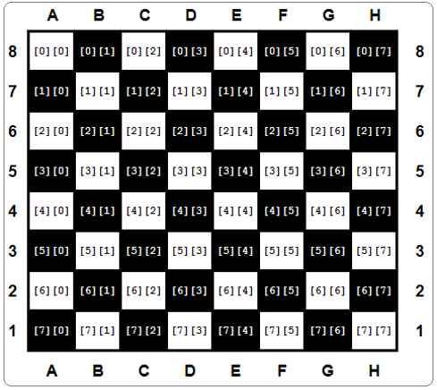
The in and not in operators
board = [[EMPTY for i in range(8)] for j in range(8)]
elem in my_list
elem not in my_list my_list = [0, 3, 12, 8, 2]
print(5 in my_list) print(5 not in my_list) print(12 in my_list)
EMPTY = "-" ROOK = "ROOK"
board = []
for i in range(8):
row = [EMPTY for i in range(8)] board.append(row)
board[0][0] = ROOK board[0][7] = ROOK board[7][0] = ROOK board[7][7] = ROOK print(board)
Lists in lists
row = []
for i in range(8): row.append(‘ ’) print (row) | row = ["-------" for i in range(8 | )]
for i in board: print (i)
List comprehensive
squares = [x ** 2 for x in range(10)]

Slide 14
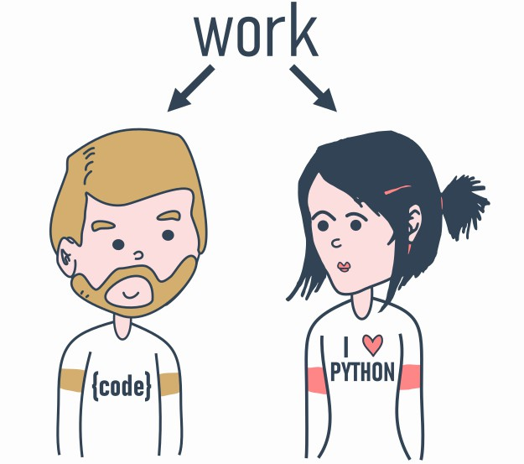
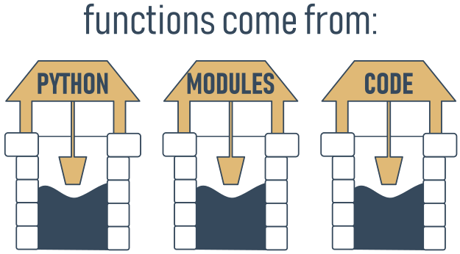
Functions: Why do we need functions?
It often happens that a particular piece of code is repeated many times in your program.
if a particular fragment of the code begins to appear in more than one place, consider the possibility of isolating it in the form of a function
Decomposition
Your first function
def function_name(): function_body
def message():
print("Enter a value: ")

Slide 15
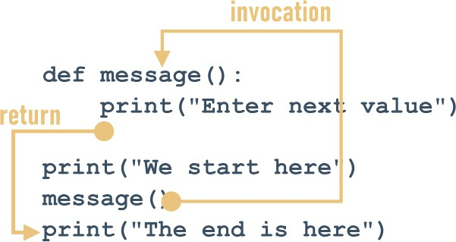
How functions work
Donot do these:
print("We start here.") message()
print("We end here.")
def message():
print("Enter a value: ")
def message(): print("Enter a value: ")
message = 1
Parameterized functions
def function(parameter): ###
def message(number):
print("Enter a number:", number)
def message(number):
print("Enter a number:", number)
message()

Slide 16
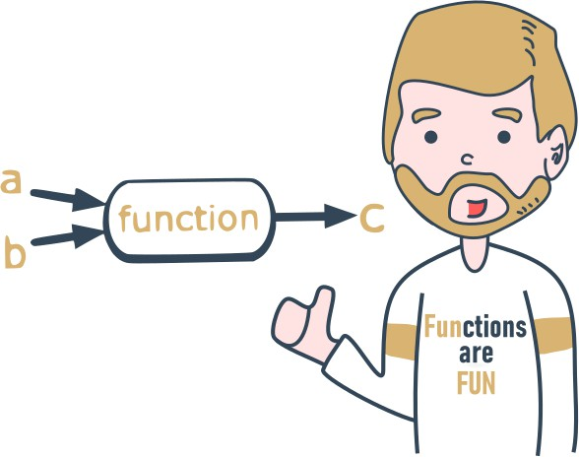
Parametrized functions:
Positional parameter passing
def my_function(a, b, c): print(a, b, c)
my_function(1, 2, 3)
def introduction(first_name, last_name): print("Hello, my name is", first_name, last_name)
introduction("Luke", "Skywalker") introduction("Jesse", "Quick") introduction("Clark", "Kent")
def message(what, number): print("Enter", what, "number", number)
message("telephone", 11)
message("price", 5)
message("number", "number")
Keyword argument passing
def introduction(first_name, last_name): print("Hello, my name is", first_name, last_name)
introduction(first_name = "James", last_name = "Bond")
introduction(last_name = "Skywalker", first_name = "Luke")

Slide 17
Mixing positional and keyword arguments
positional argument passing def adding(a, b, c): print(a, "+", b, "+", c, "=", a + b + c) adding(1, 2, 3) |  |  | keyword arguments adding(c = 1, a = 2, b = 3)
 | 1 + 2 + 3 = 6 |  |  | 2 + 3 + 1 = 6
 |  | 3 + 2 + 1 = 6
adding(3, c = 1, b = 2)
adding(3, a = 1, b = 2) |  | 3 + 2 + 1 = 6
adding(4, 3, c = 2) | TypeError | : adding() got multiple values for argument 'a'
introduction("James", "Doe")
def introduction(first_name, last_name="Smith"):
print("Hello, my name is", first_name, last_name)
introduction(first_name="William")
introduction("Henry“)

Slide 18
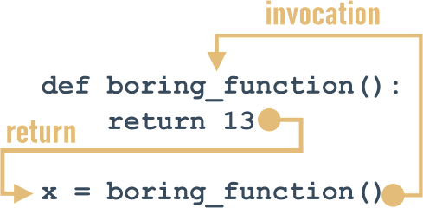
Effects and results: the return instruction
return without an expression
def happy_new_year(wishes = True): print("Three...")
print("Two...")
print("One...") if not wishes:
return
print("Happy New Year!")
def boring_function(): print("'Boredom Mode' ON.") return 123
print("This lesson is interesting!")
boring_function()
print("This lesson is boring...")
happy_new_year() Three...
Two...
One...
Happy New Year!
happy_new_year(False) Three...
Two...
One...

Slide 19
lists and functions
None
None is a keyword
def strange_list_fun(n): strange_list = [] for i in range(0, n):
strange_list.insert(0, i) | [4, 3, 2, 1, 0]
return strange_list print(strange_list_fun(5))
value = None
if value is None:
print("Sorry, you don't carry any value")
print(None + 2)
TypeError: unsupported operand type(s) for +: 'NoneType' and 'int'
def strange_function(n): if(n % 2 == 0):
return True print(strange_function(2)) print(strange_function(1))
True
Functions and scopes
None
def scope_test():
x = 123 scope_test() | NameError: name 'x' is not defined
print(x)
def my_function():
print("Do I know that
variable?", var) var = 1 my_function() print(var)

Slide 20
the global keyword
simple functions: Fibonacci numbers
global name
global name1, name2, ...
def fib(n): if n < 1:
return None
if n < 3:
return 1
def my_function():
global var
var = 2
print("Do I know that variable?", var)
var = 1 my_function() print(var)
elem_1 = elem_2 = 1 the_sum = 0
for i in range(3, n + 1):
the_sum = elem_1 + elem_2 elem_1, elem_2 = elem_2, the_sum
return the_sum
for n in range(1, 10): # testing print(n, "->", fib(n))

Slide 21
See you in the Lab ☺

